Slide 1


Slide 2
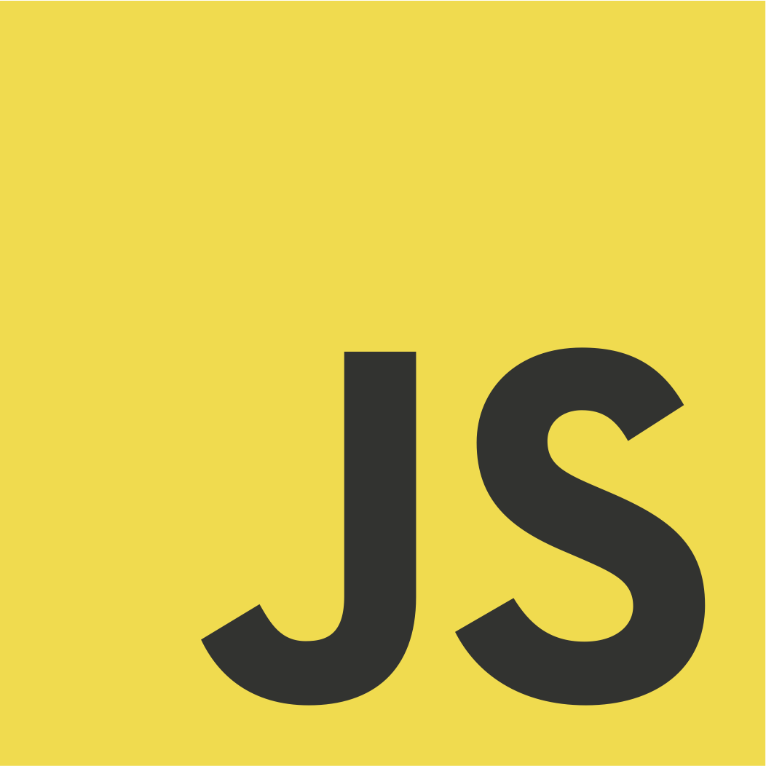
The Full Stack
JAVASCRIPT Course

Slide 3
Pre-Requisite
A basic understanding of HTML
A basic understanding of CSS

Slide 4
What We Will Cover
Complete Java Script
All Modern Features
Learn How To Use JS At Front End
MERN Batch Students Will Also Learn To Use JS At Back End

Slide 5
What We Will Cover In This Course
01
02
03
JS Basics
DOM
ES
All the JavaScript fundamentals: things like variables, data types, if/else statements, loops, functions, objects, arrays, etc
How to make JavaScript code interact with web pages: DOM manipulation.
A deep dive into JavaScript new features of ES6 like arrow functions , forEach() method etc

Slide 6
What We Will Cover In This Course
04
05
Ajax
JQuery
Learn Ajax & JSON to get data from external APIs, learn about the latest techniques (such as the Fetch API) to make an AJAX request
Learn all concepts of JQuery from basic to advanced, learn to add beautiful Effects & Animations to website as well as AJAX calls

Slide 7
If You Are From MERN Batch , You Will Also Learn
06
07
08
09
React JS
Node JS
Express JS
Mongo
All important React 18 concepts like JSX, Props, State, Hooks, arrays, etc
Learn how to use JS outside the browser using Node through event loop, blocking vs non-blocking code, streams, modules, File I/O etc
Learn to build Express web servers and APIs, add routes , learn to use templates etc
Deep dive into how to work with data in NoSQL databases , perform CRUD operations with MongoDB

